Slide 1
Evaluation verschiedener Fahrspurerkennungsalgorithmen
Masterprojekt – SDI Community Lab

Slide 2
Motivation / Anforderung
RC-Car SDI Community Lab
Smart Camera Praktikum

Slide 3
Ablauf Fahrspurerkennung

Slide 4
Filter

Slide 5
Filter
Canny-Edge
Sobel-Magnitude
Row-Filter
Color-Thresholding
Multi Filter
Bird View Transformation

Slide 6
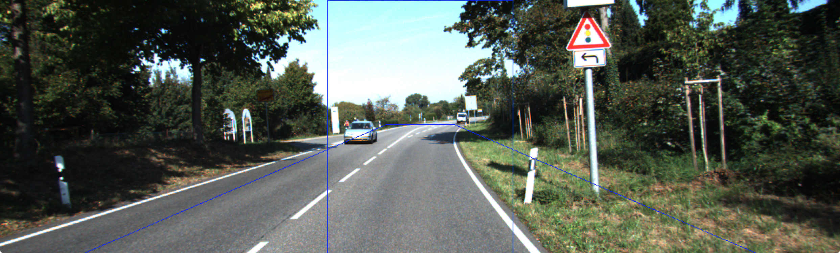
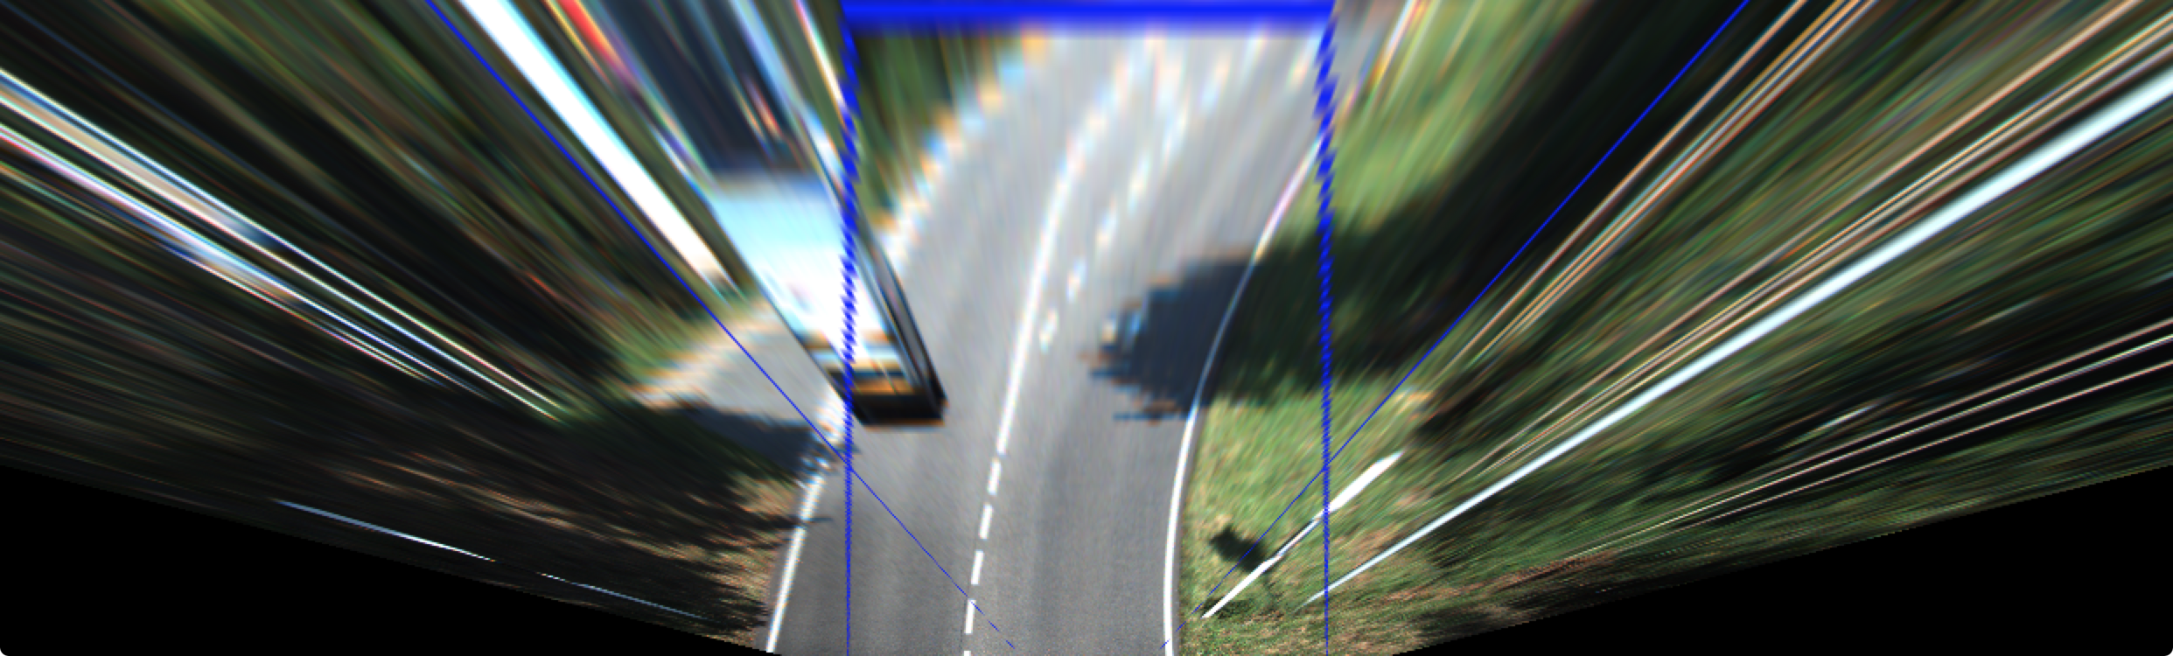
Bird View Transformation

Slide 7
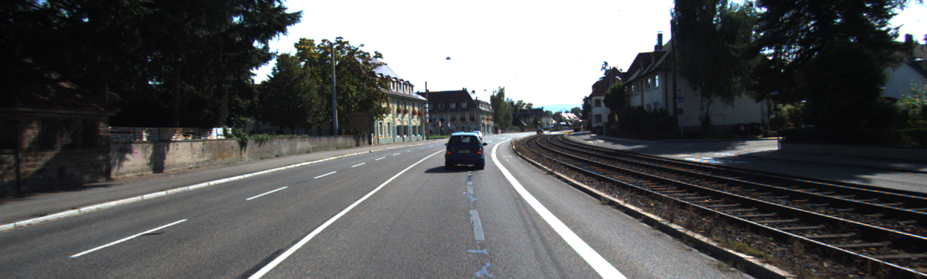
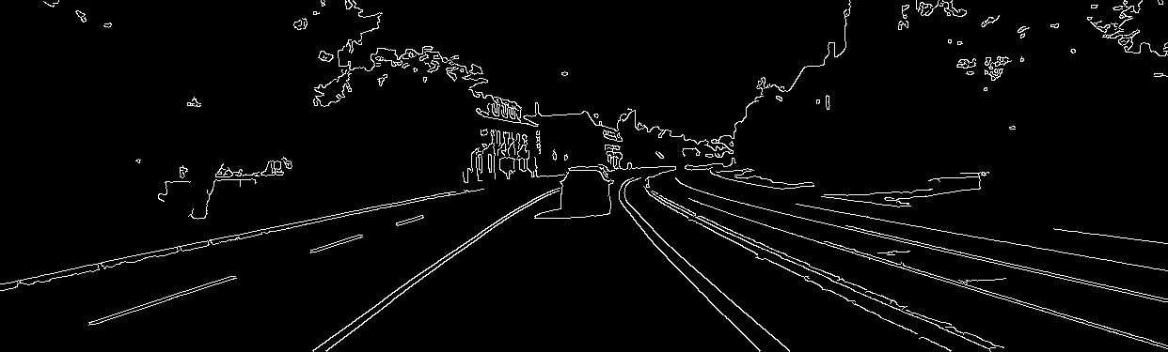
Canny-Edge (1/4)

Slide 8
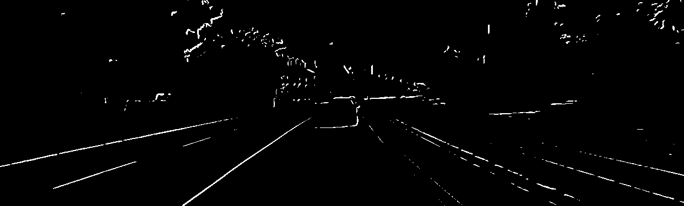
Sobel-Magnitude (2/4)

Slide 9
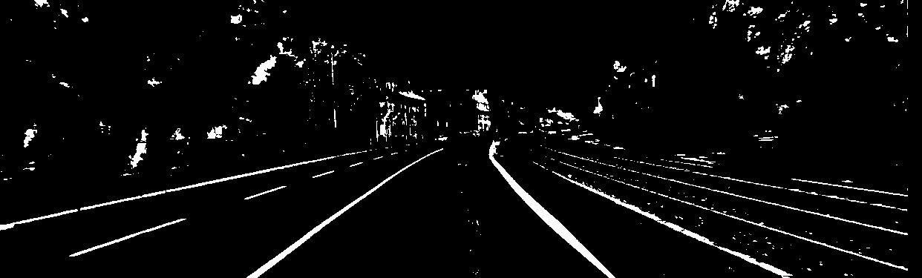
Row-Filter (3/4)

Slide 10
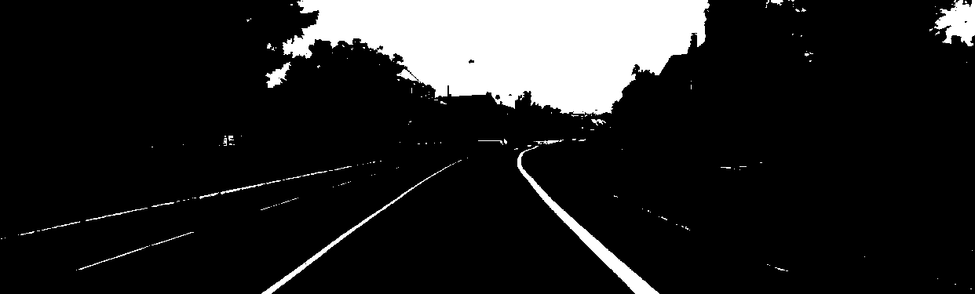
Color-Thresholding (4/4)

Slide 11
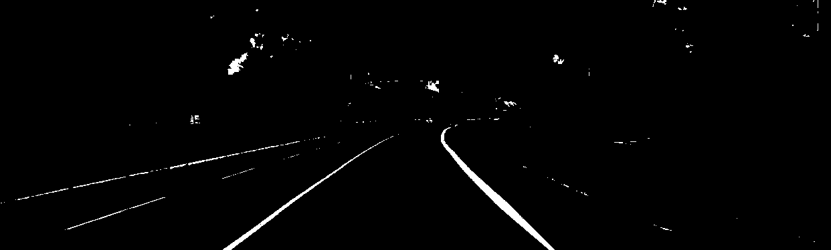
Multi Filter
OUT: Multi
IN 1: Color-Threshold
IN 2: Row-Filter

Slide 12
Lane Detection Algorithmen

Slide 13
Algorithmen
Partitioned Hough
ALM
Sliding Window
Fixed Window
Random Lines

Slide 14
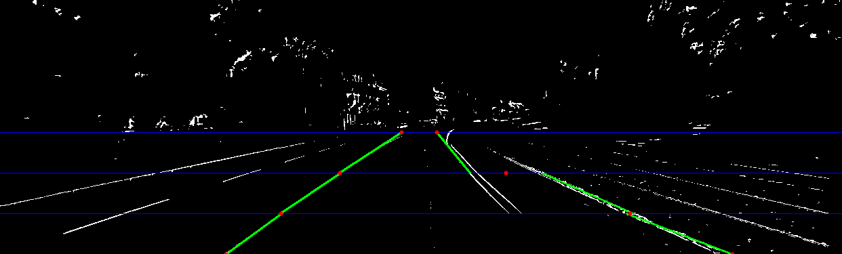
Partitioned Hough (1/5)

Slide 15
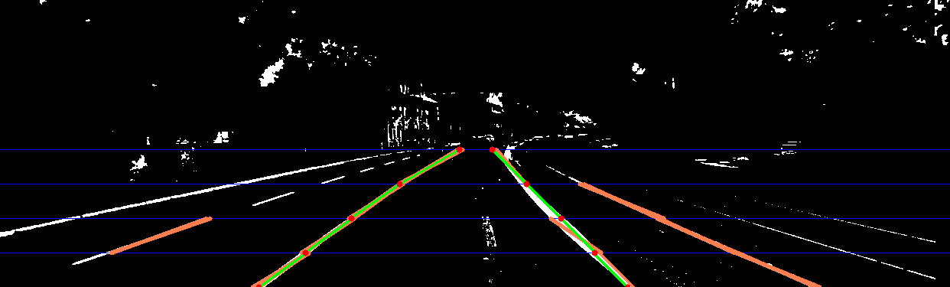
ALM (2/5)

Slide 16
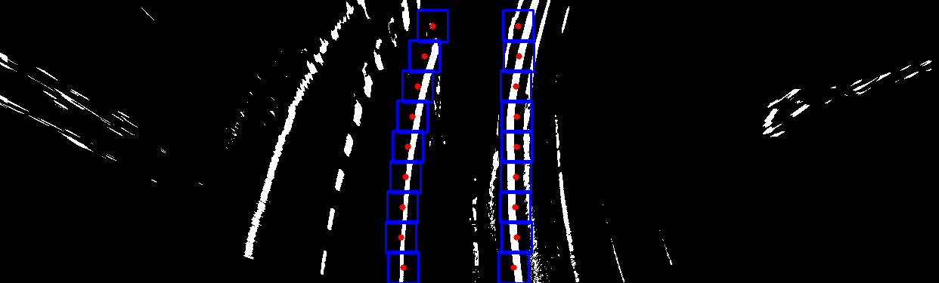
Sliding Window (3/5)

Slide 17
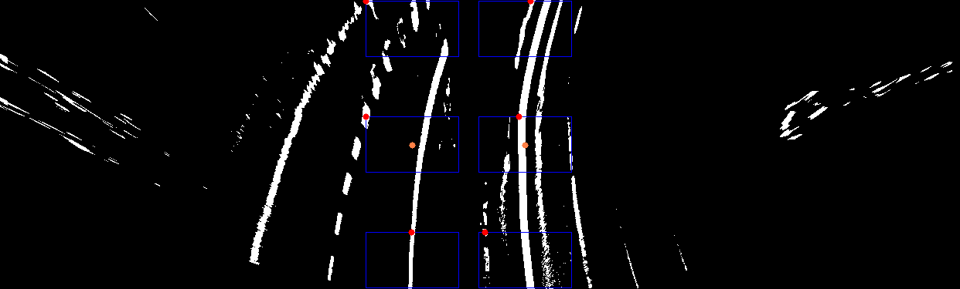
Fixed Window (4/5)

Slide 18
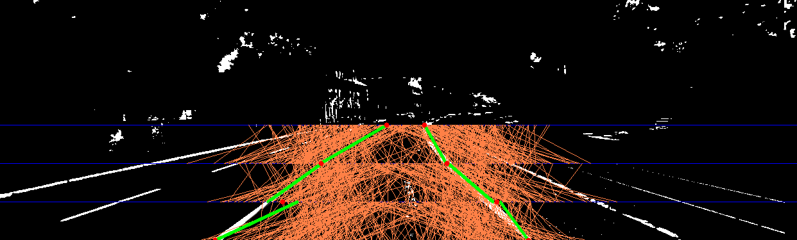
Random Lines (5/5)

Slide 19
Evaluation

Slide 20
Parameterraum
Fixe
Variable
Bird View

